Slide 1
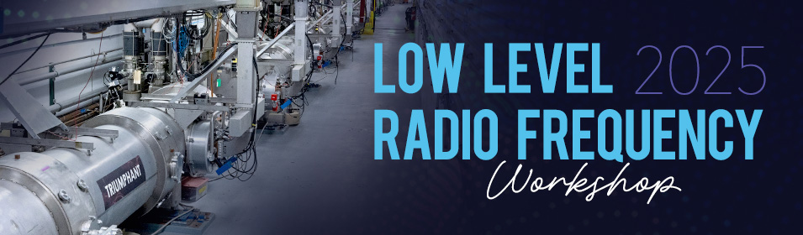
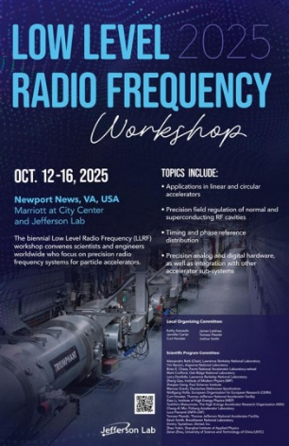
Progress in Advanced Ferroelectric Technologies for Fast SRF Cavity Tuning
Alexei Kanareykin
on behalf of Euclid’s team
in collaboration with Jefferson Lab, Helmholtz-Zentrum Berlin (HZB) and CERN
LLRF’25
Newport News, VA
October 14, 2025
Supported by the DOE NP SBIR DE-SC0007630

Slide 2
Outline
Introduction Euclid Techlabs
Products & Capabilities Snapshot
SRF Technologies at Euclid
Ferroelectric materials for accelerators
Ferroelectric Fast Reactive Tuner tested at CERN
Ferroelectric tuner development for CEBAF
iSAS Program in Europe
Conclusion
www.euclidtechlabs.com

Slide 3
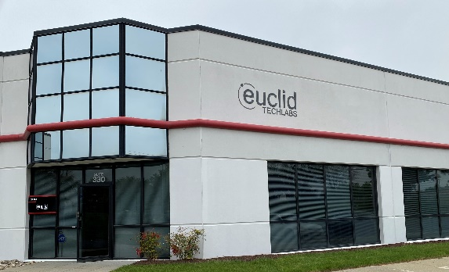
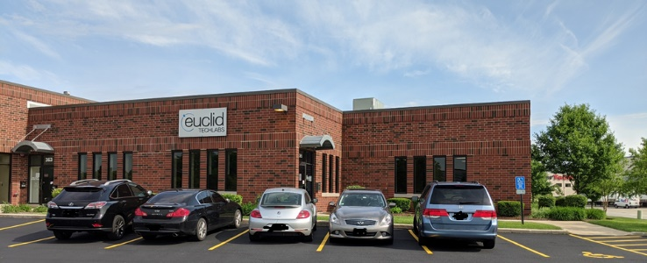
Euclid Techlabs
Euclid Techlabs is a U.S.-based firm specializing in electron devices and advanced materials. After 20+ years serving the particle accelerator R&D market, we now ship a much wider-ranging product portfolio around the globe, from semiconductor photocathodes and superconducting photoinjectors, to ultrafast electron microscopy, to domestically-grown technical diamonds, ferroelectric fast tuners to arc-free high power microwave windows using our proprietary ceramic technologies.
EUCLID EAST • DC HQ and Materials
EUCLID WEST • Chicago Central Shops and Test Labs
As pioneers in advanced electron device engineering, we excel in tackling complex design challenges. Our agile, milestone-driven project management approach ensures optimal resource allocation and timely delivery. We collaborate with leading accelerator laboratories across the United States, the Department of Defense, CERN, and numerous global institutions. Our innovative solutions have garnered a diverse clientele spanning North America, Europe, and Asia.
www.euclidbeamlabs.com

Slide 4
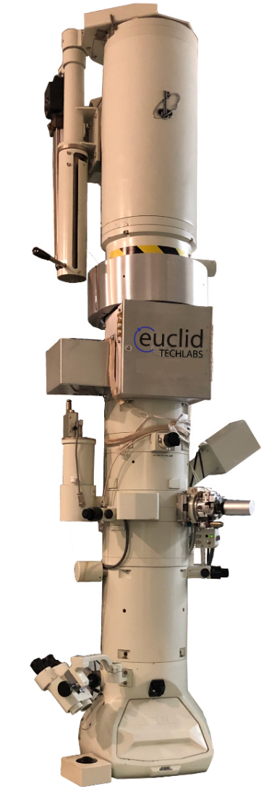
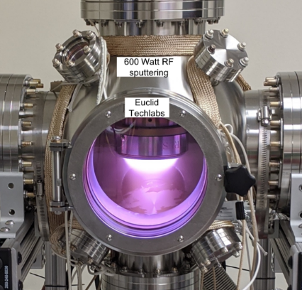
Products & Capabilities Snapshot
Products
UltraFast Pulser (UFPTM) for TEM
Compact X-Ray Source
L-band High Peak Current Linac
Electron sources and cathodes
SRF components (cryomodules, cavities)
RF high power windows
Fast reactive tuners for SRF
BPMs other accelerator components
CVD and HPHT diamonds,
Capabilities
Femtosecond Laser Ablation System
Thin Film Deposition Lab
TEM Testing Lab
High precision 4-axis turning/milling
Radiation Shielding/Testing Lab
Diamond Growth Lab
Photocathode Lab
Ceramic/ferroelectric Lab

Slide 5
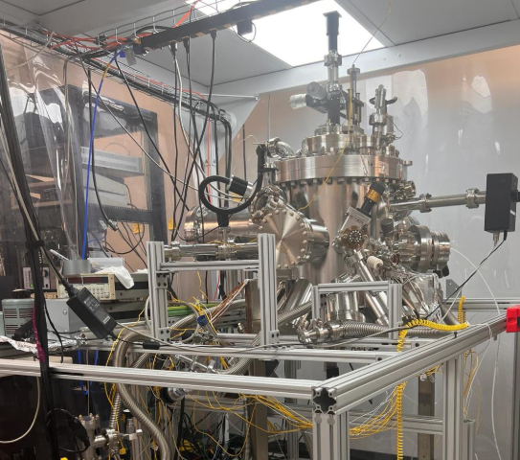
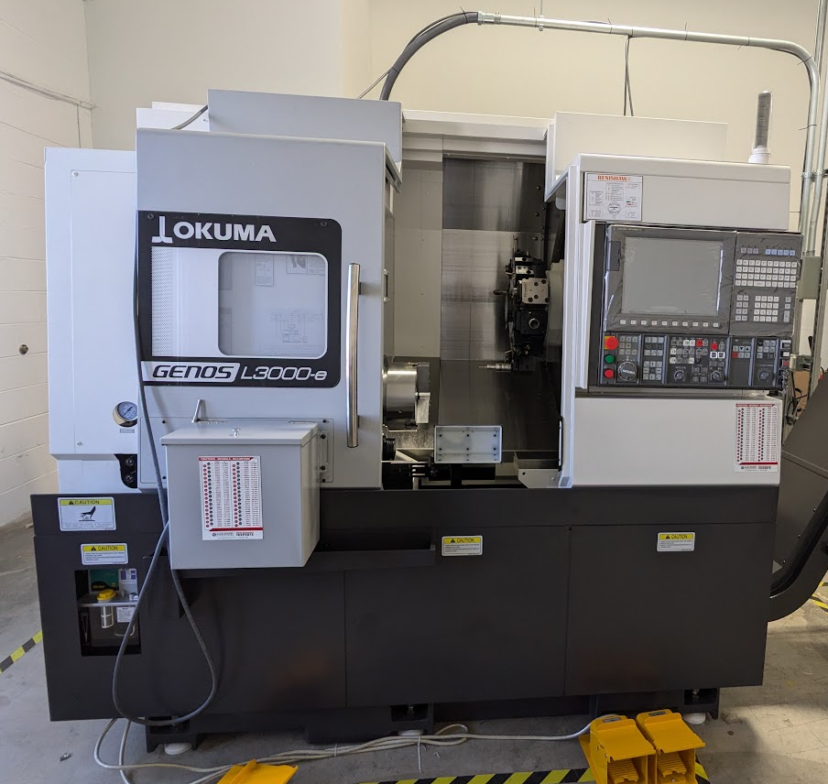
In-house Capabilities
MBE system for Cs₃Sb/Cs₂Te growth
High precision 4-axis turning/milling

Slide 6
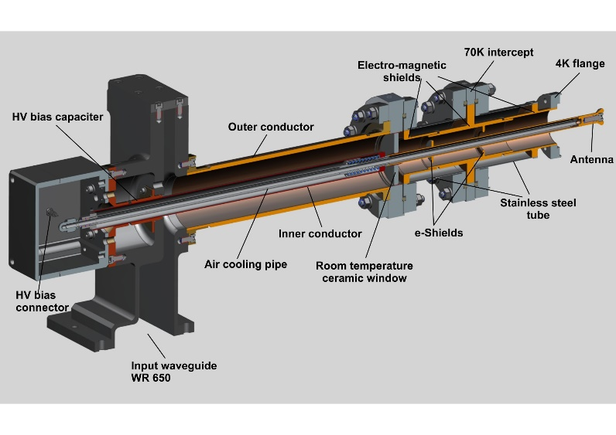
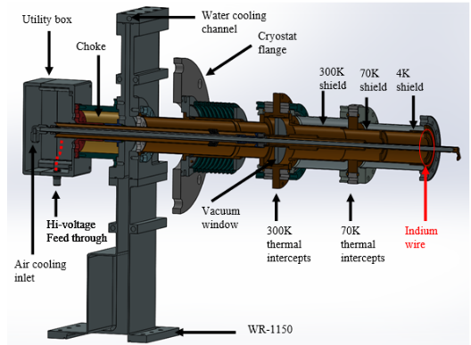
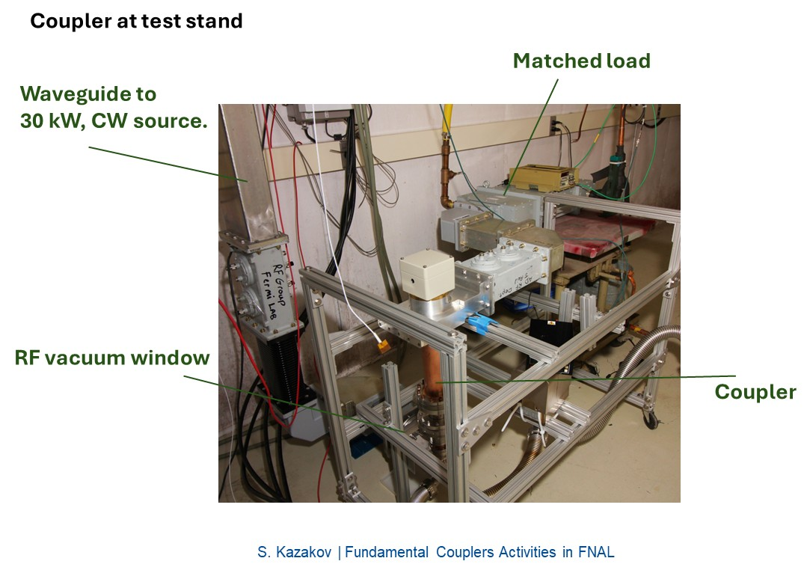
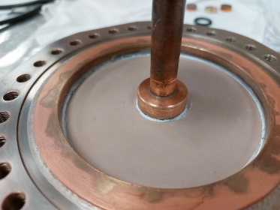
High Power Couplers for SRF
1.3 GHz coupler
SRF coupler with extra low heat leak to 4K
Conductive ceramic RF window
In collaboration with FNAL (S.Kazakov)
Notes:
Euclid develops cavity and couplers for electrons and protons machines ranging from low to high beta as well as conduction cooled cryostats. Our coupler design is Crucial for conduction cooling apps with limited cooling capacity

Slide 7
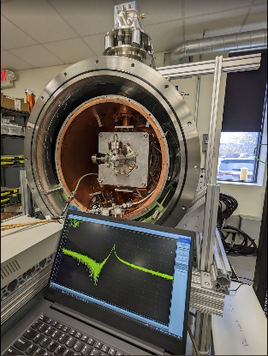
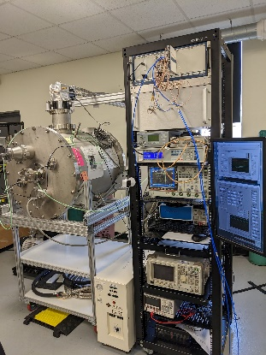
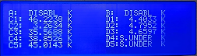
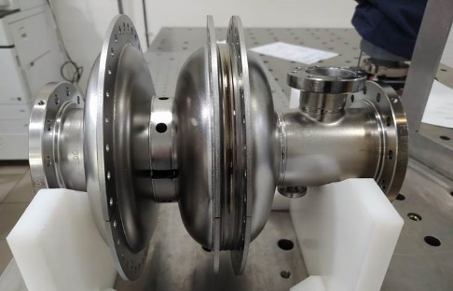
SRF Photogun at 4K
Development of MeV-range ultrafast electron diffraction/microscopy (UED and UEM) is a priority for the DOE. Euclid is developing the SRF photocathode gun that is a promising candidate to produce highly stable electrons for UEM/UED applications
Euclid’s Conduction Cooled Cryomodule
(in collaboration with FNAL, BNL and Jlab)
1.3 GHz SRF Photogun

Slide 8
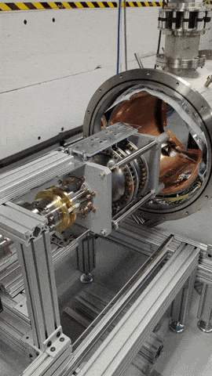
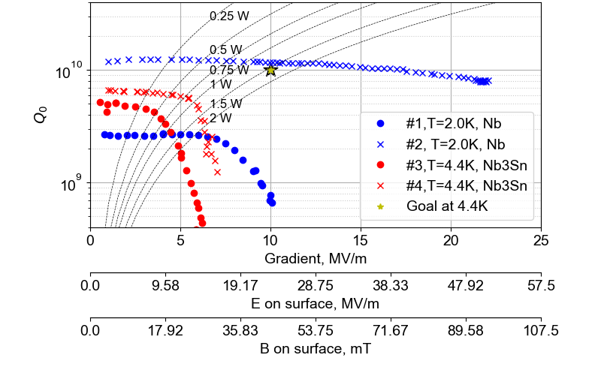
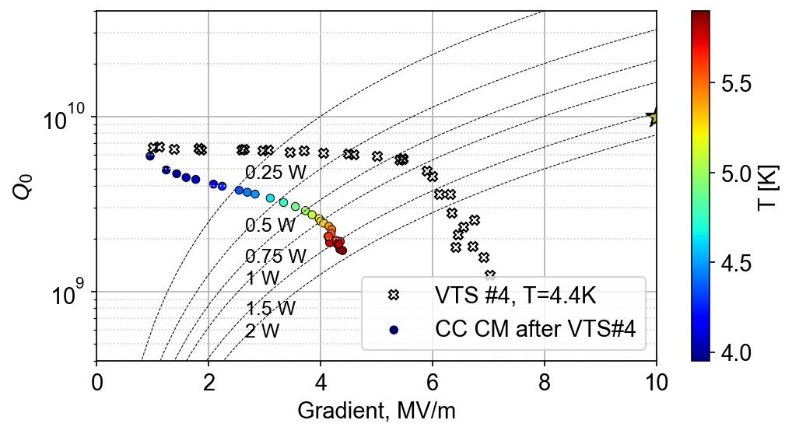
Euclid’s Conduction cooled 4K photoinjector for UEM/UED
The cryomodule was fully commissioned:
Magnetic field below 5mG
Cavity was successfully cooled according to specs
LLRF system developed in house and successfully commissioned
Pure Nb SRF gun was tested at 2K resulted in Q0=10¹⁰ and reached Ez=47MV/m on axis field and Eacc=22MV/m with just BCP
Nb3Sn test in VTS at 4.2K revealed contamination, nevertheless was tested in conduction cooled cryomodule (CC CM).
Eacc=4.3MV/m achieved in CC CM
The beam test at ANL AWA facility is currently being commissioned.
in collaboration with FNAL, BNL and ANL
Euclid’s Conduction Cooled Cryomodule
Pure Nb cavity tests: Eacc>20MV/m
Nb3Sn test in He_{L} and CM

Slide 9
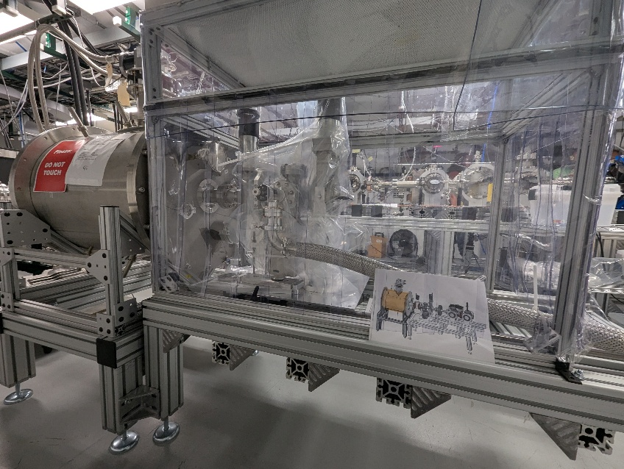
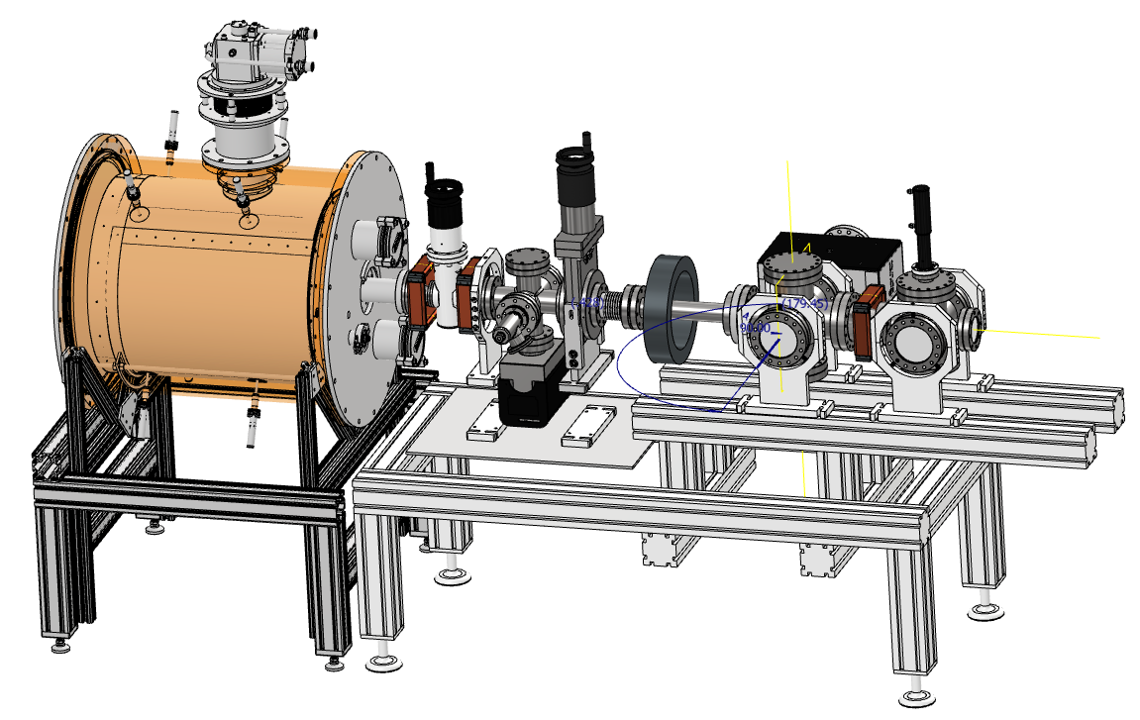
UEM/UED photoinjector beam test:
“SRF grade” (particle free) clean beamline is installed
Rest of the beamline is being built
Optics
Laser cross
Beam diagnostics cross
Beam test is Fall 2025
Jun 2025
Commissioned
Under construction
Clean “Glove Box”
Beam
Laser

Slide 10
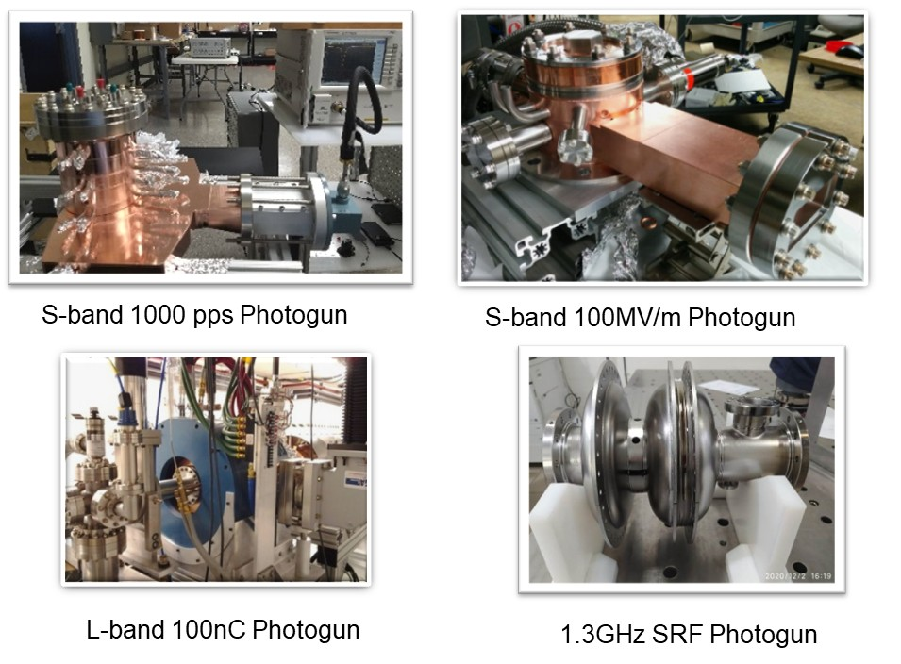
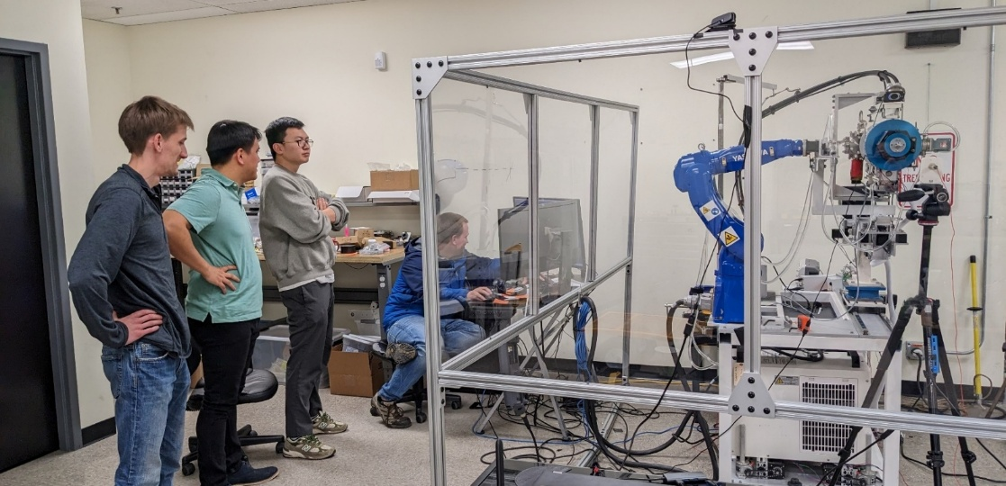
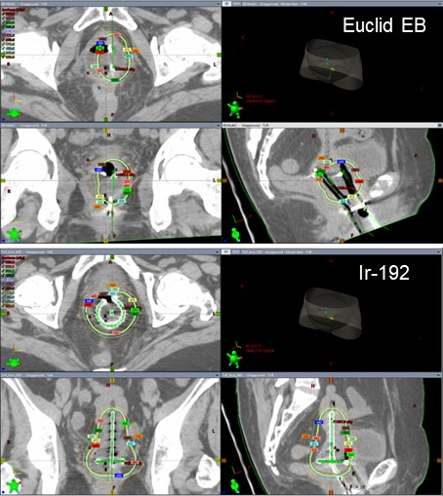
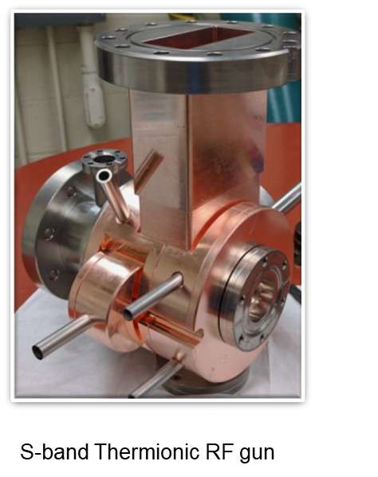
Normal conducting LINACs and Electron Sources
Photoguns and Thermionic guns
Brachytherapy linac system
Tight engagement with Chicago Proton Center oncologists, NWU.
Established the expertise in radiation simulation and dosimetry measurement.

Slide 11
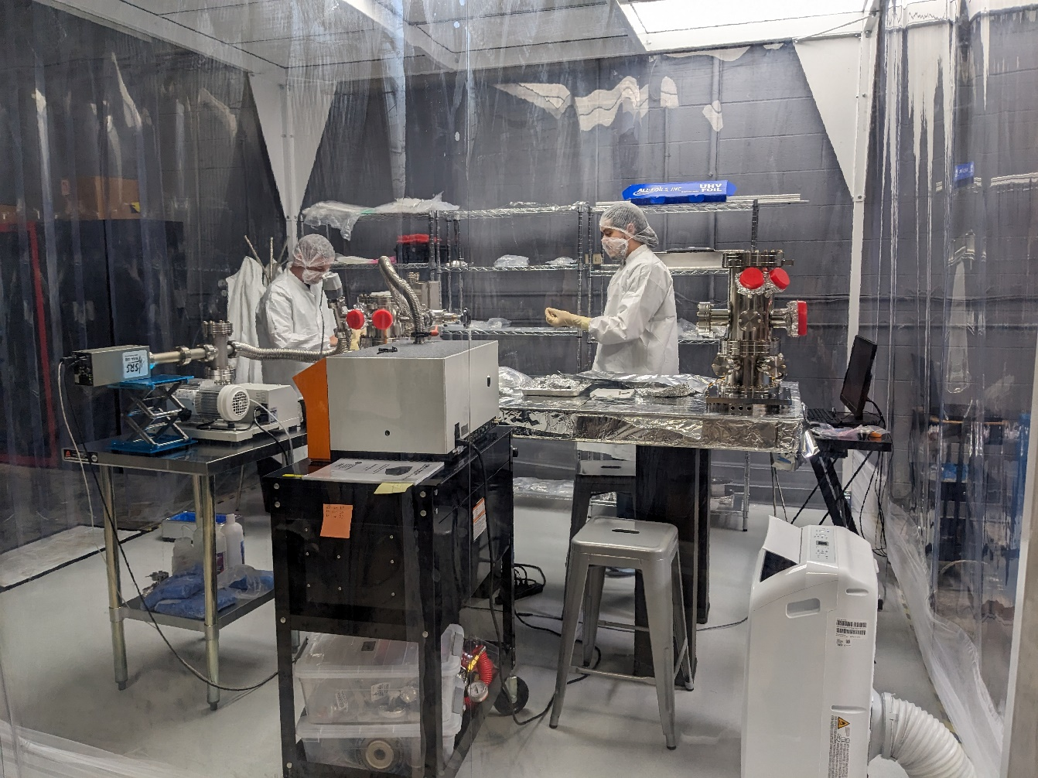
Euclid Plays an essential role in critical components assembly for ANL-SLAC Cavity-based FEL Experiment at LCLS-II
The X-ray FEL oscillator (XFELO) and the X-ray regenerative amplifier FEL (XRAFEL) concepts use this technique
Both schemes require a high repetition rate electron beam, an undulator to provide FEL gain, and an X- ray cavity to recirculate and monochromatize the radiation.
A joint Argonne National Laboratory (ANL) and SLAC National Laboratory (SLAC) collaboration aimed at enabling these schemes at LCLS-II.
Euclid has been actively participating this project by assembling, testing, and QA all critical components in Euclid Class10k cleanroom at Euclid West facility.
Clean room facility at Bolingbrook IL

Slide 12
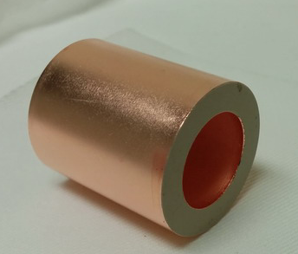
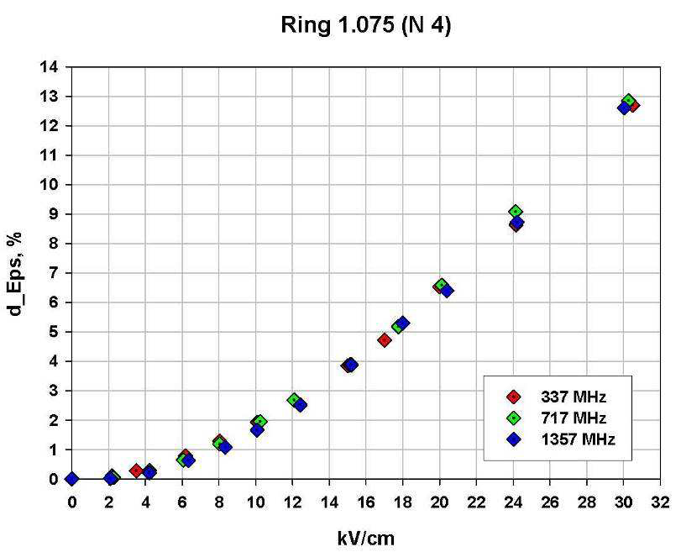
Motivation Fast Ferroelectric Tuner
Ferroelectrics have unique intrinsic properties that make them extremely attractive for high-energy accelerator applications. Their response time is ≈ 10⁻¹⁰ s for ceramic compounds which make ferroelectric promising candidates for the tuning and switching RF devices.
A fast controllable tuners would allow microphonics compensation for the SRF accelerator with low beam loading.
Nonlinear ferroelectric microwave components can control the tuning or the input power coupling for rf cavities. Applying a bias voltage across a nonlinear ferroelectric changes its permittivity. This effect is used to cause a phase change of a propagating rf signal or change the resonant frequency of a cavity. The key was the development of a low loss highly tunable ferroelectric material.
Courtesy of N. Shipman, CERN

Slide 13
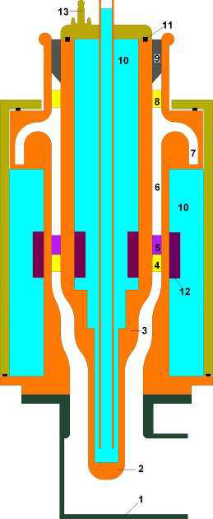
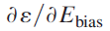
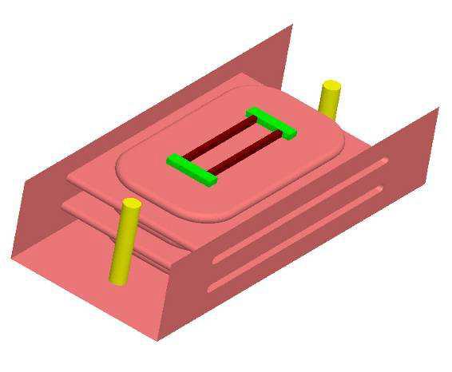
History of the Fast Ferroelectric Tuner Development
Ferroelectric phase and amplitude control was developed during the 1990’s¹, in 2003 V. Yakovlev proposed RF switching by changing the frequency of a ’switching NC cavity’ containing ferroelectric material². In 2006 Ilan Ben-Zvi initiated F-FRT research at BNL whereby the frequency of a SRF cavity would be controlled by an external ferroelectric tuner
Initial project to develop an ultra-fast (~1us) phase shifter/tuner using ferroelectric was carried out in collaboration with Omega-P/Yale University (V. Yakovlev, S. Kazakov) and BNL (I. Ben-Zvi) in 2004-2010³. The phase shifter/tuner was intended to control of coupling of accelerating structures ( phase/amplitude), and to tune resonance frequency of the cavity. With this project, Euclid developed a ferroelectric material with dielectric constant ɛ~ 500, tanδ~2x10⁻³ at 1.3GHz but low tuning range, ~2/ kV/cm^{3,4}.
In 2013, I. Ben-Zvi (BNL) proposed a new topic for the DOE SBIR/STTR program on the ferroelectric fast reactive tuner (F-FRT) development for microphonics compensation. It allowed Euclid to develop a new improved ferroelectric ceramic with ɛ~ 150, tanδ<1x10⁻³ at 1.3GHz and the tuning range up to Δε/ε~10% at 15 kV/cm⁵.
A new, simple coaxial tuner design (S. Kazakov) for the F-FRT became feasible⁵, and the 400 MHz tuner prototype was fabricated by Euclid and tested at CERN in 2019 with the 400 MHz SRF cavity⁶.
¹R. Babbitt et al., 1994. “US Patent, US5334958A, 1993.
²V. Yakovlev et al. AIP Conf.Proc. 691,187, 2003.
³S. Kazakov et al. PRAB 13, 113501, 2010
⁴A. Kanareykin et al. Proc. EPAC 2006, 3251, 2006.
⁵A. Kanareykin et al. Proc. IPAC2013, 2486, 2014.
⁶N.Shipman et al. Proc. SRF2019, Dresden,WETEB7, 2019.

Slide 14
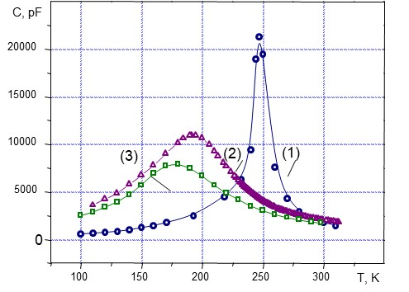
Fast tuning ferroelectric elements
Dielectric constant has to be low (~ 100-150)
Loss factor has to be low ~ 1x10⁻³ at 1 GHz and ~1x10⁻⁴ at 100 MHz
Tuning range has to be high ~ 6-8% at 15kV/cm
Can be done with (Ba, Sr)TiO₄+Mg oxides
Dielectric constant of pure BST ~ 1000, and it’s lossy. To reduce both eps and tanδ, one has to develop a mixture (solid solution) of BST ferroelectric and low loss linear ceramic
Curie temperature dependence on Mg-oxide content. Curie temperature shift with Mg based oxide increase

Slide 15
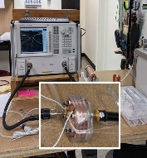
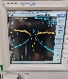
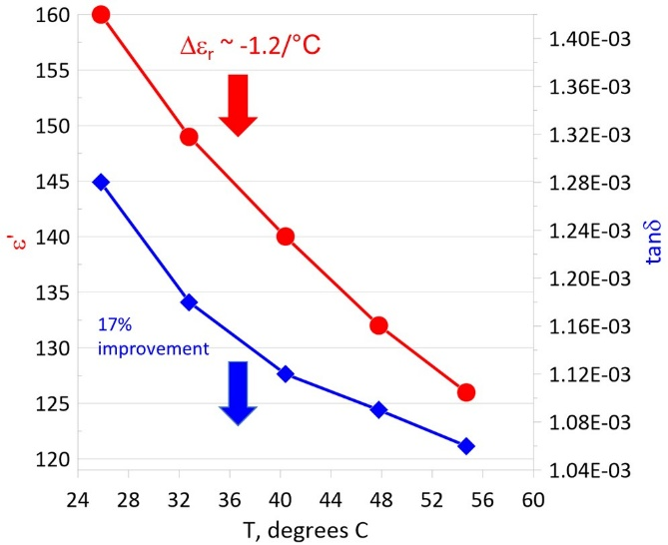
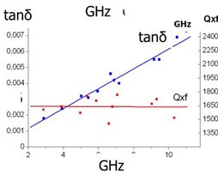
ε and tanδ vs. temperature and frequency
For lower dielectric constant, tanδ is significantly reduced.
Q×f (GHz)=const
tanδ=1/Q
for ~1 GHz and ε~150
Q×f~1,000, tanδ~1x10⁻³
Dielectric constant and tanδ measurements in the temperature range T=20⁰С-60⁰С at 400 MHz for the BST(M) ferroelectric material: tanδ=1.3×10⁻³ T=22⁰С and ~ 17% improvement at T=55⁰С.
Dielectric constant weakly depends on the frequency
Loss tangent increase linearly with frequency

Slide 16
Ferroelectric ceramic properties
Parameters | Value
dielectric constant, ε | ~150
tunability, Δε | ~ 10% at 15kV⋅cm⁻¹ of the bias field
response time | < 10 ns
loss tangent at 1.3 GHz, tanδ | ~1×10⁻³
breakdown limit | 200 kV/cm
thermal conductivity, K | 7.02 W/m-K
specific heat, C | 0.605 kJ/kg-K
density, ρ | 4.86 g/cm³
coefficient of thermal expansion | 10.1×10⁻⁶ K⁻¹
temperature tolerance, ∂ε⁄∂T | (1-2 units) K⁻¹

Slide 17
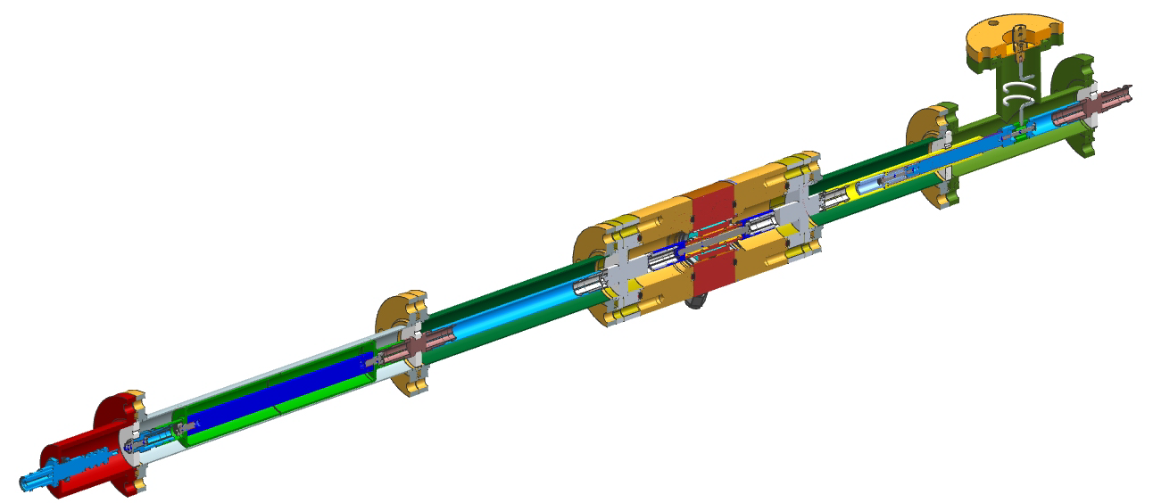
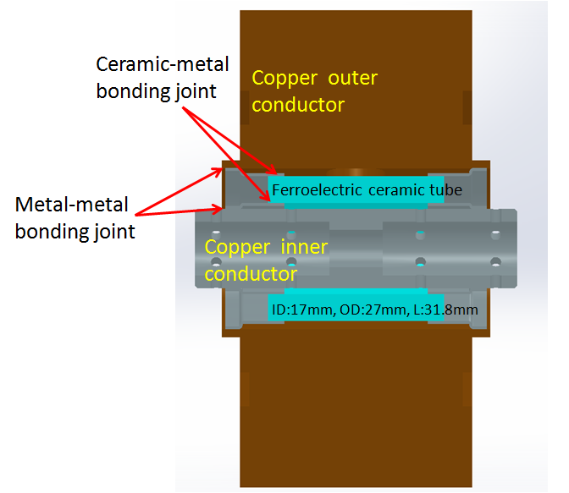
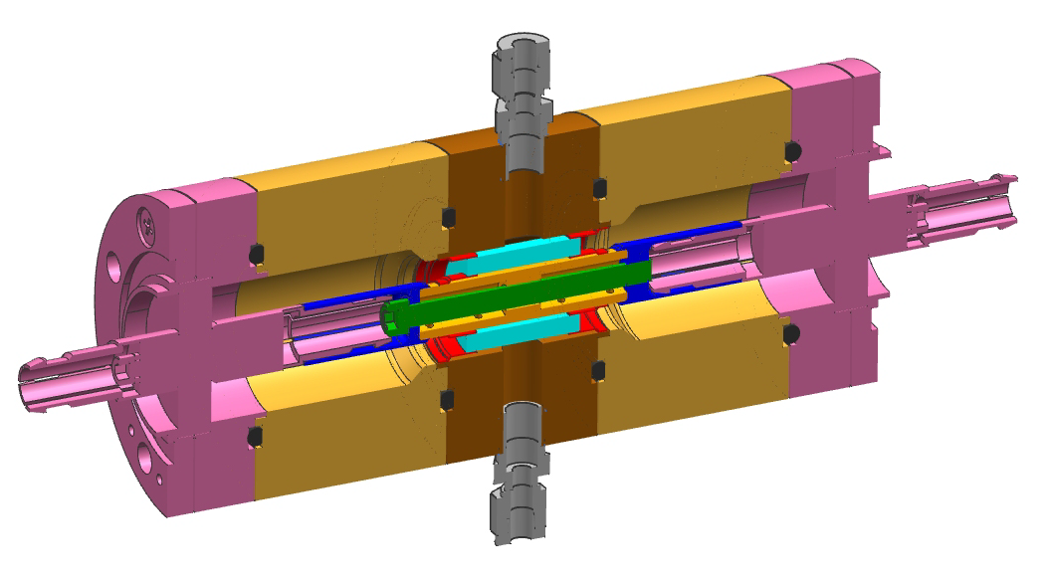
BST Based Tuner Design (assembly)
design of S. Kazakov and V. Yakovlev

Slide 18
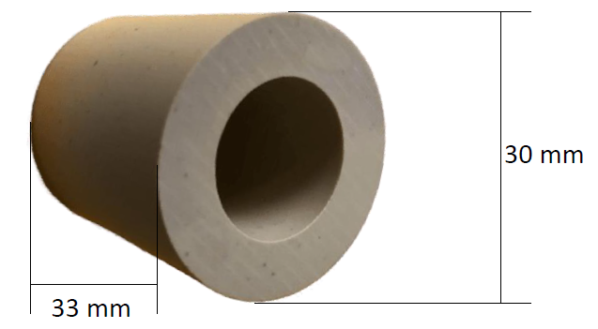
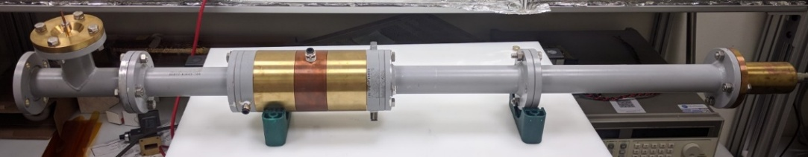
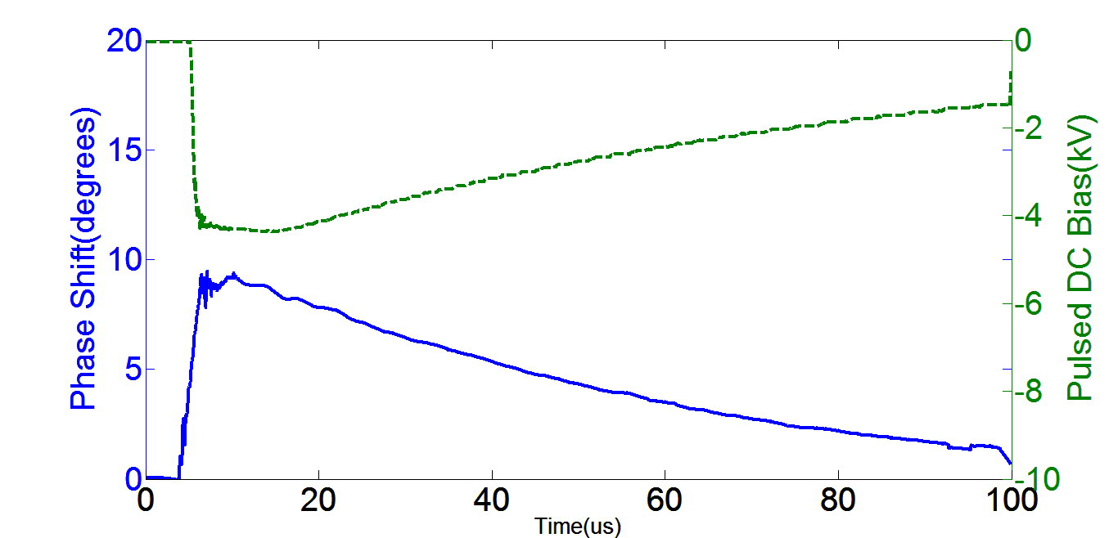
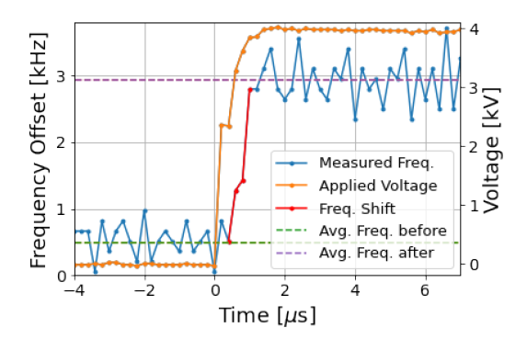
F-FRT low power tests at Euclid at CERN
Assembled F-FRT
Ferroelectric element before metallization
N. Shipman, et al., IPAC’21, 1305, 2021
Measured at CERN frequency response at 600 ns of a cavity to a 4 kV high voltage pulse (orange) applied to the connected FE-FRT.
Measured at Euclid phase shift vs. time at biasing voltage applied (~ μs range response time)

Slide 19
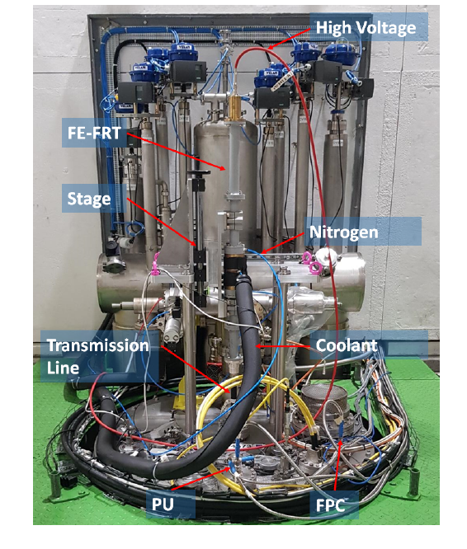
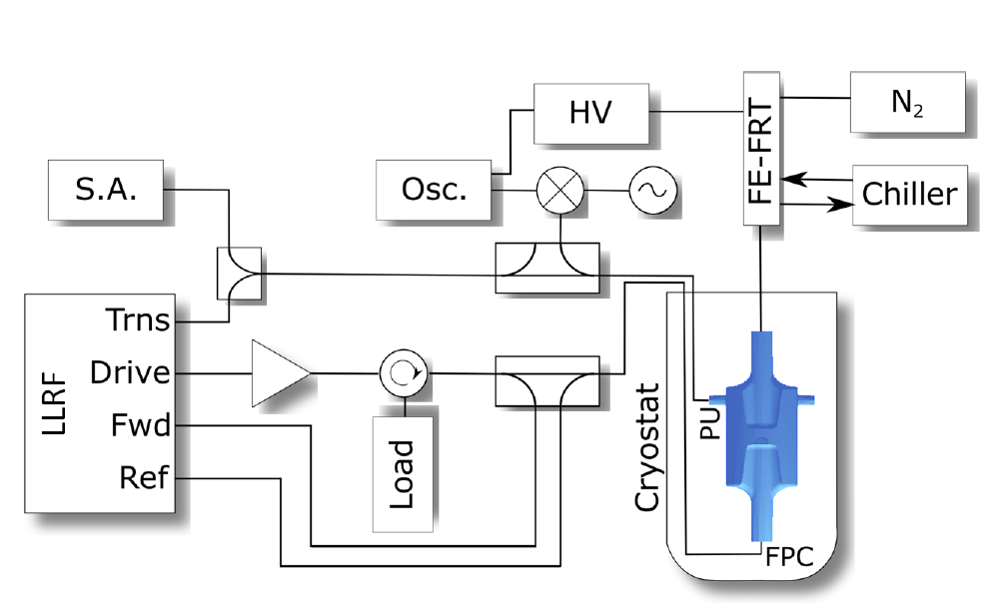
F-FRT test with SRF Cavity at CERN
Experimental Setup
FE-FRT mounted on cryostat.
N. Shipman, et al., SRF’19, WETEB7

Slide 20
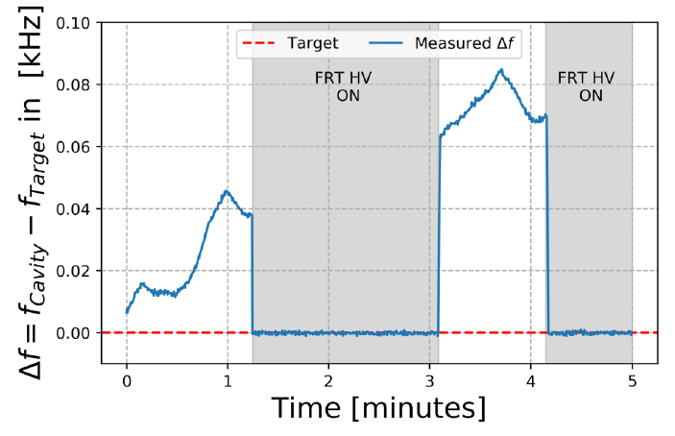
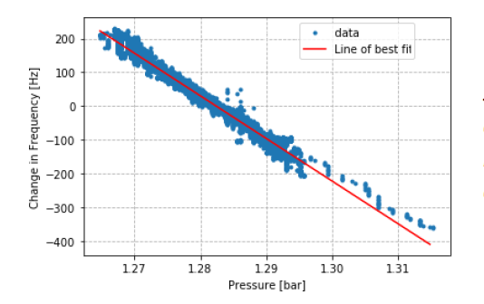
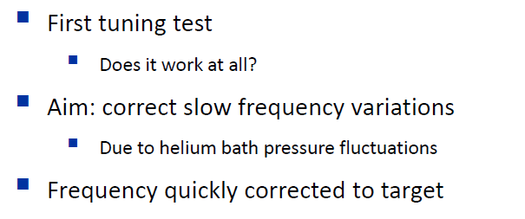
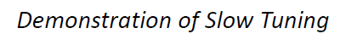
Slow Tuning
N. Shipman, et al., IPAC’21,

Slide 21

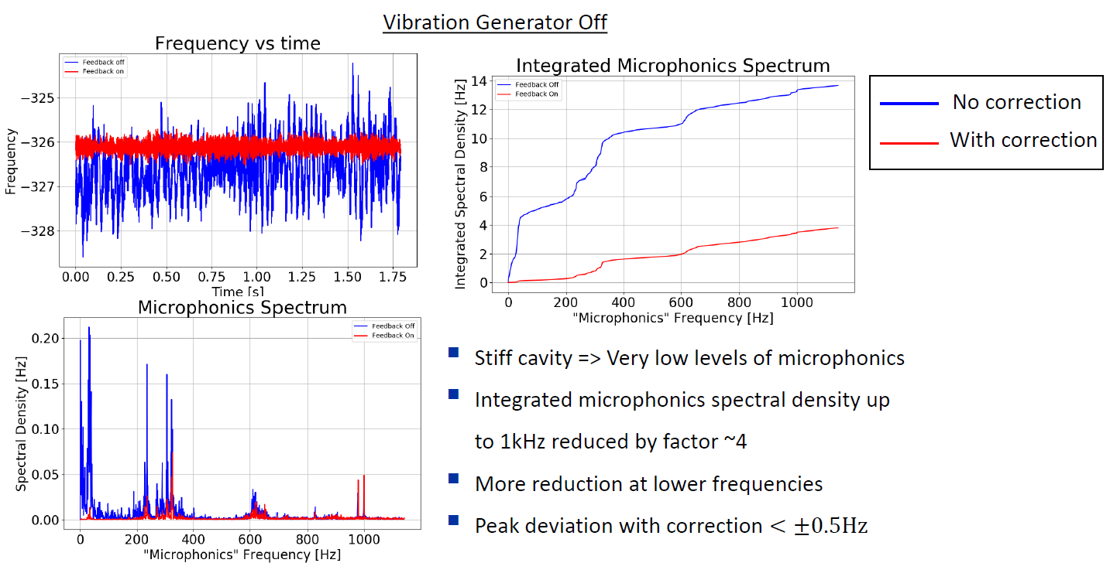
Microphonic Suppression (1)
N. Shipman, et al., IPAC’21,
First ever Ferroelectric Fast Reactive Tuner (FE-FRT) test with a superconducting cavity

Slide 22



Summary of F-FRT Testing at CERN
N. Shipman, et al., IPAC’21,
*N. Shipman. SRF’19

Slide 23



FRT for 1.5 GHz Single Port Cavity
Ferroelectric tuning element (red) with alumina matching section (yellow)
C100 cavity, and C100 cryomodule with FPCs in CEBAF section SL25, Jlab, upper left – two port cavity.
Ferroelectric tuner and MT (upper corner) in the LLRF schematic of C100
Euclid Techlabs is developing the first fast ferroelectric tuner for a SRF accelerator that is currently in operation – CEBAF at JLAB. In comparison with our first tuner prototype, it requires a new configuration, with a single RF power port for both the klystron and the tuner. This is the only option for the current C100 cryomodules at CEBAF, and many other projects.

Slide 24


Simulink modeling of the FRT microphonics compensation via the single FPC
Although it is non-ideal to use FRT through FPC, it is possible to maintain Qext and compensate the microphonics simultaneously.
Simulink modeling shows the klystron power demanding can be reduced by ~25% in the case of Jlab C100 cavities.
~25% reduction
Klystron power as needed to compensate the microphonics
FRT OFF
FRT ON
FRT with 10% loss
13.9 MV
Cavity voltage
Emulated microphonics signal
Cavity Phase
90⁰

Slide 25






Current Status of the 1.5 GHz FRT
Engineering design
HOM analysis
Thermal analysis
3 kW of CW power causes 7° temperature rise with rather small convection coefficient. Water cooling substantially reduces temperature rise.
Euclid has carried out thermal and RF measurements of improved ferroelectric ceramic, completed the tuner RF and thermomechanical design, and is currently finishing the mechanical engineering design for fabrication. HOM analysis is complete too.

Slide 26


iSAS Program
Innovate for Sustainable Accelerating Systems (iSAS)
Goal is establishing collaboration to expedite the development of novel energy-saving technologies to SRF particle accelerators.

Slide 27


iSAS Program –cont.
TA#1: energy-savings from RF
TA#2: energy savings from the cryogenics
TA#3: energy savings from the beam
INT#1: integrate into the design of a sustainable LINAC cryomodule
INT#2: integrate into existing LINAC cryomodules at RIs
INT#3: integrate towards turn-key solutions and applications in industry
[1] https://isas.ijclab.in2p3.fr/
[2] https://indico.ijclab.in2p3.fr/event/11291/overview

Slide 28

iSAS Program
Innovate for Sustainable Accelerating Systems (iSAS)
The Horizon Europe iSAS project [1] focuses on improving accelerator efficiency and includes the integration of a ferroelectric fast reactive tuner (FE-FRT) to enhance energy conservation. Applications under this initiative include an
FE-FRT for 400 MHz transient beam loading compensation in the LHC (CERN),
FE-FRT systems for microphonics compensation in 1.3 GHz SRF cavities (HZB),
FE-FRTs for energy recovery linac (ERL) applications (HZB),
retrofitting FE-FRTs into existing HL-LHC cryomodules (CERN)

Slide 29


FRT in the U.K.
Graeme Burt, Daresbury Lab
Lancaster University
FRT can reduce power demands for low beamloading machines by reducing the overhead needed for microphonics. For machines with reactive beamloading by switching the frequency during abort gaps

Slide 30




Tree-stub tuner for variable loads, CEBAF
A. Hutton, A.Costilla, JLab
Using a three-stub tuner to minimize the reflected power only works if the load has a constant impedance, which is often, but not always, true. If the load is varying in time, the best that can be done is to match the stub tuner to the average value.
HFSS model of a single stub tuner attached to a WR650 rectangular waveguide (b) S₁₁, parameters vs. the ferroelectric sleeve’s dielectric.
In collaboration with JLab

Slide 31

First Workshop on Ferro-Electric Fast Reactive Tuners (FE-FRTs)
HZB to host First Workshop on Ferro-Electric Fast Reactive Tuners (FE-FRTs)
Join us for the first-ever workshop on Ferro-Electric Fast Reactive Tuners (FE-FRTs), taking place at Helmholtz-Zentrum Berlin (HZB) on November 13–14, 2025
https://indico.ijclab.in2p3.fr/event/11291/overview

Slide 32
In conclusion,
New ferroelectric ceramic material was developed with the set of parameters satisfying the Ferroelectric Fast Reactive Tuner (F-FRT) requirements for microphonic compensation, transient detuning, and fast switching.
First F-FRT prototype was designed, fabricated and successfully demonstrated at CERN
The Horizon Europe iSAS project focuses on improving accelerator efficiency and includes the integration of a ferroelectric fast reactive tuner (FE-FRT) to combat microphonics and enhance energy conservation.
In the U.S., the FE-FRT technology is under development for microphonics compensation in CEBAF

